Slide 1
Nexperia result VI
By Huang Kaiyi

Slide 2
To compare
Models: ResNet18 or VGG19_bn
Model modification: None or +STN or +attention map

Slide 3
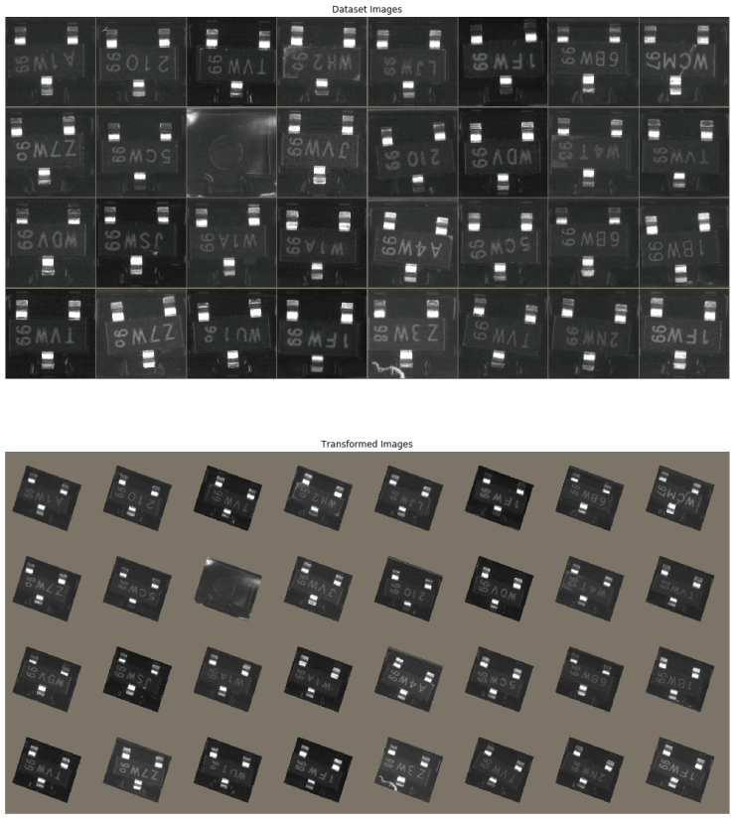
Spatial transformer networks (STN)
Learn to predict region of interest and align the same object to the same angle (rotation), magnitude (scaling), and position (translation)
Motivation: to obtain humans ability to recognize the a familiar object regardless of its variations

Slide 4
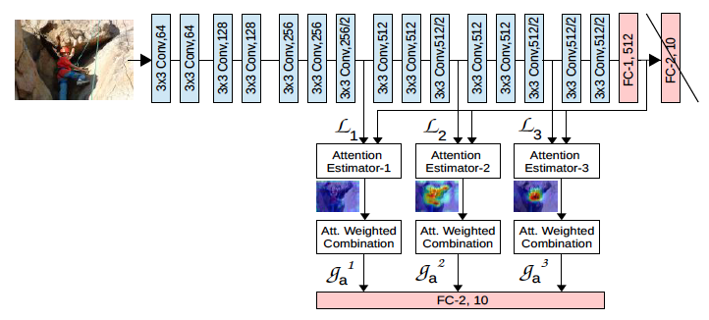
Attention map
Insert attention networks amid conv layers and output feature maps
Combine the feature maps (L) with the last vector (G) before the last fully connected layer and pass it through the classifier, so high resolution features are preserved till the end
Each L acting on G learns regions of interest by returning an attention map (A)

Slide 5
test RESULTS (778 of 3830 bad) with random preprocessing
% (std 10-2) |  | RESNET18 | VGG19_BN | R_STN | VGG_STN | R_ATT
AUC |  | 99.83 (0.00) | 99.66 (0.007) | 99.70 (0.04) | 99.83 | 99.63
TPR>=99.1% | FPR | 1.25 (0.08) | 1.60 (0.137) | 3.70 (0.85) | 2.78 | 4.39
TPR>=99.3% |  | 2.21 (0.41) | 1.80 (0.138) | 6.85 (2.62) | 3.76 | 5.04
TPR>=99.5% |  | 3.60 (0.31) | 8.06 (0.390) | 13.70 (3.99) | 6.38 | 11.10
TPR>=99.7% |  | 4.71 (0.40) | 16.67 (0.821) | 23.81 (9.04) | 7.72 | 30.50
TPR=1 |  | 36.80 (2.06) | 100.00 (0.0) | 43.40 (10.63) | 23.14 | 48.87
VGG19_BN: VGG19 with back normalization
R_STN: ResNet18 with STN
VGG_STN: VGG19_BN with STN
R_ATT: ResNet18 with attention networks

Slide 6
Different crops on test data (Resnet)
# of layers |  | 18 |  |  | 34 |  |  | 50
Crop Style |  | CenterCrop | FiveCrop | TenCrop | CenterCrop | FiveCrop | TenCrop | CenterCrop | FiveCrop | TenCrop
AUC% (std 10-2) |  | 99.83 (0.00) | 99.78 (0.01) | 99.70 (0.01) | 99.84 (0.00) | 99.83 (0.00) | 99.80 (0.00) | 99.84 (0.00) | 99.81 (0.00) | 99.86 (0.00)
TPR>=99.1% | FPR | 1.25 (0.08) | 2.26 (0.29) | 7.21 (0.31) | 1.32 (0.09) | 1.20 (0.12) | 4.96 (0.43) | 1.50 (0.10) | 1.07 (0.08) | 1.91 (0.43)
TPR>=99.3% |  | 2.21 (0.41) | 2.89 (0.48) | 8.33 (0.80) | 2.15 (0.23) | 2.00 (0.18) | 5.83 (0.41) | 1.73 (0.09) | 1.24 (0.06) | 3.10 (0.54)
TPR>=99.5% |  | 3.60 (0.31) | 10.26 (2.14) | 11.94 (0.04) | 4.01 (0.25) | 2.93 (0.21) | 7.45 (0.55) | 2.26 (0.15) | 1.50 (0.08) | 3.91 (0.42)
TPR>=99.7% |  | 4.71 (0.40) | 12.21 (2.00) | 13.84 (0.04) | 4.42 (0.42) | 15.84 (1.65) | 9.15 (0.48) | 3.61 (0.36) | 3.34 (0.46) | 7.79 (0.94)
TPR=1 |  | 36.80 (2.06) | 62.18 (7.09) | 24.62 (0.07) | 46.69 (1.92) | 38.49 (1.14) | 15.59 (1.35) | 59.85 (1.86) | 52.86 (1.58) | 10.65 (0.41)
CenterCrop: crop the image at the centre for size 224x224
FiveCrop: crop at the four corners and the centre for size 224x224
TenCrop: do a FiveCrop, flip horizontally and do another FiveCrop
P.S.: for FiveCrop and TenCrop, we averaged the results for one image

Slide 7
Noisy labels
Clean good labels are learned quickly (early learning)
Clean defect labels’ learning speeds vary, generally slower than good labels
Noisy labels overfit later (doomed to overfit)
Clean defect and noisy labels generally fluctuate more violently than clean good labels

Slide 8
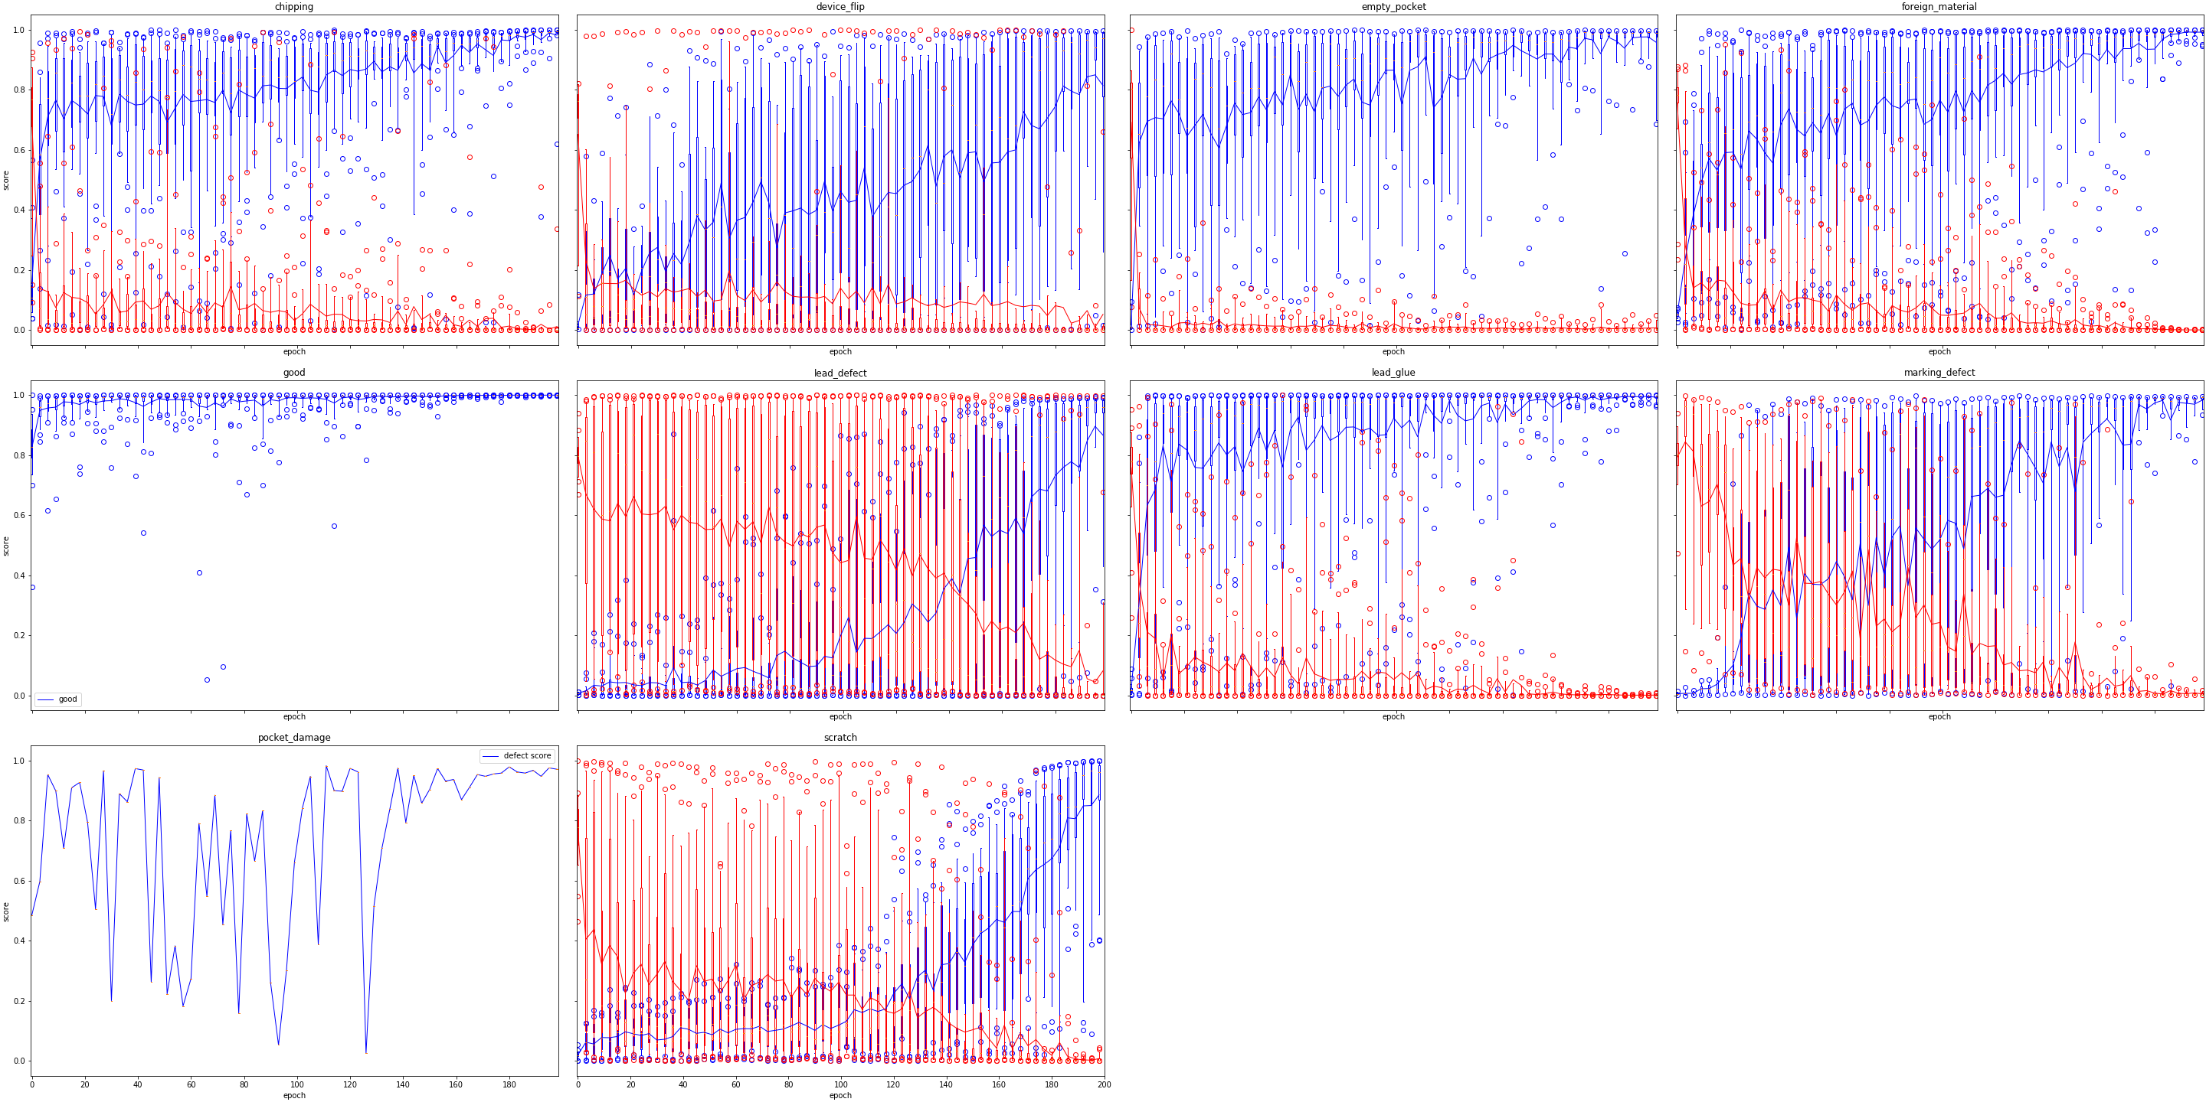
Clean labels
Good
True class

Slide 9
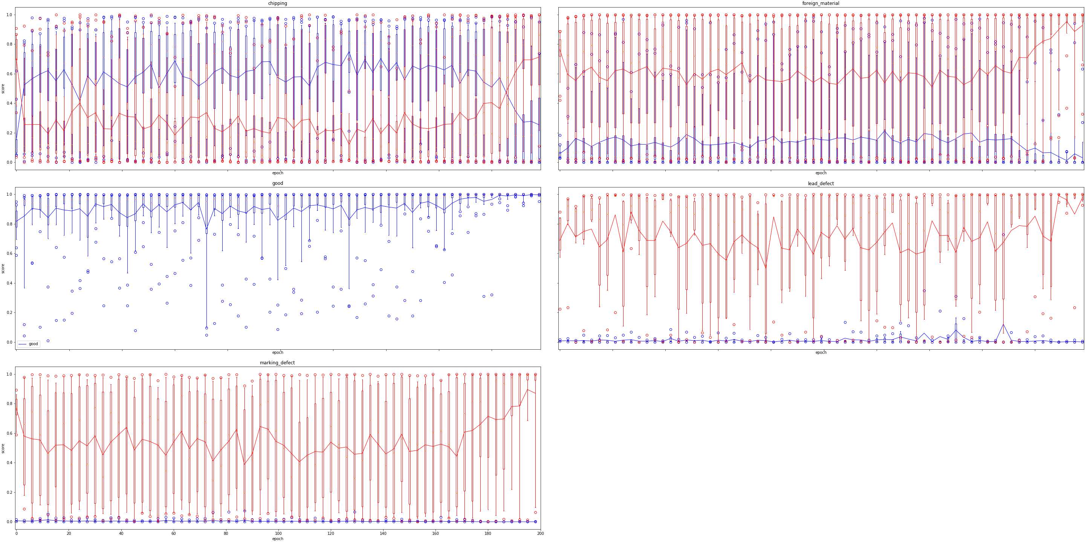
noise
Good
True class

Slide 10
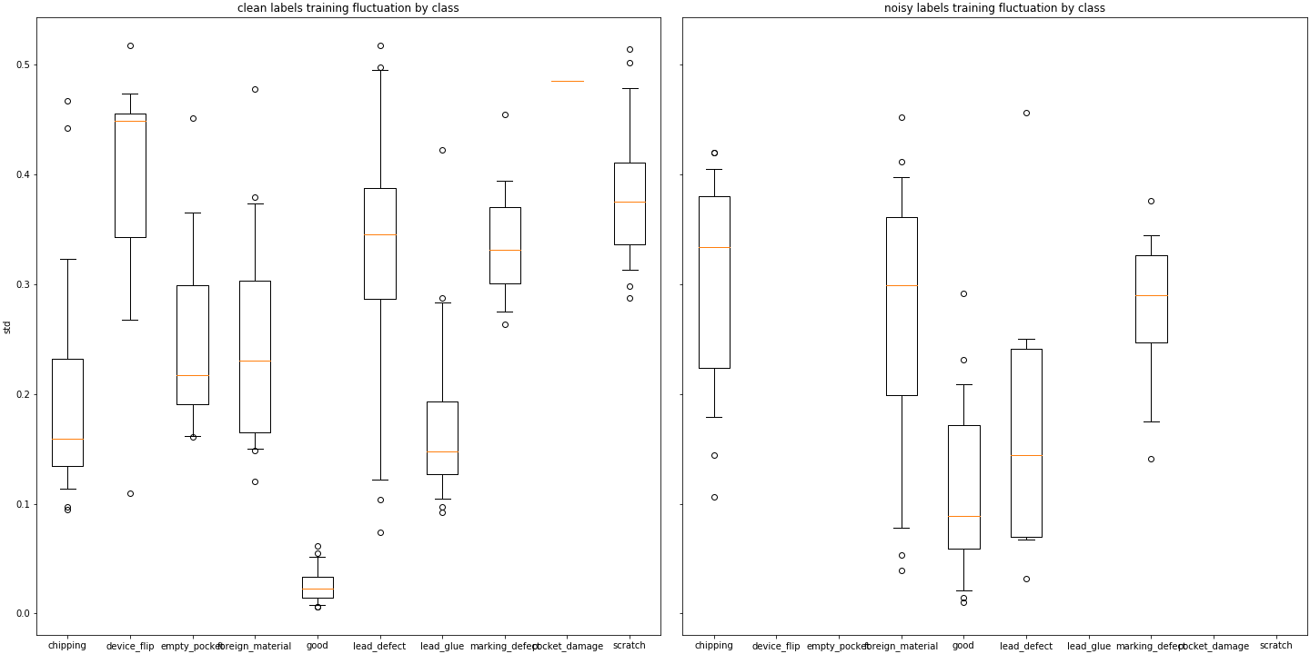
fluctuations

Slide 11
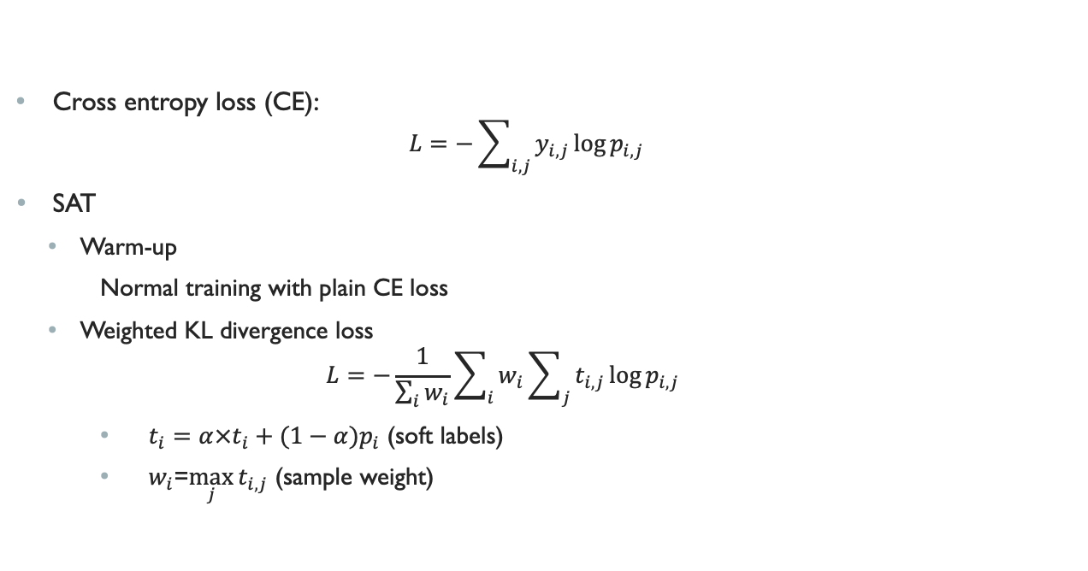
Self-adaptive training (SAT)
Cross entropy loss (CE):
$$L=−\sum_{i,j}{y_{i,j}\log{p_{i,j}}}$$
SAT
Warm-up
Normal training with plain CE loss
Weighted KL divergence loss
$$L=−\frac{1}{\sum_{i}{w_{i}}}\sum_{i}{w_{i}\sum_{j}{t_{i,j}\log{p_{i,j}}}}$$
$t_{i}=α×t_{i}+(1−α)p_{i}$ (soft labels)
$w_{i}$=$\max_{j}{t_{i,j}}$ (sample weight)

Slide 12
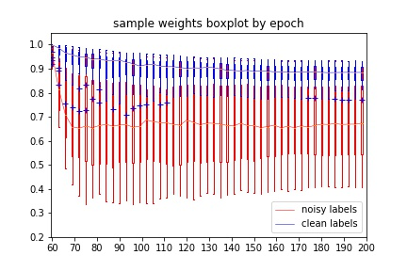
Sample Weights on noisy labels

Slide 13
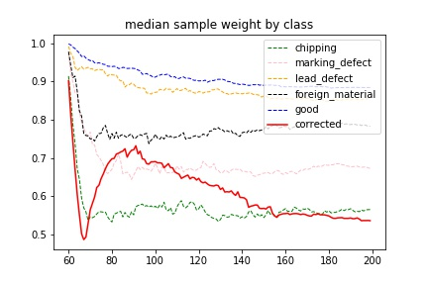
Sample Weights by Class

Slide 14
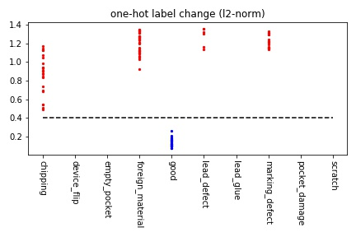
Label Change on noisy labels
$y$–axis: ${\left\|t−y\right\|}_{2}$, where $t$ is the soft label, $y$ the assigned label

Slide 15
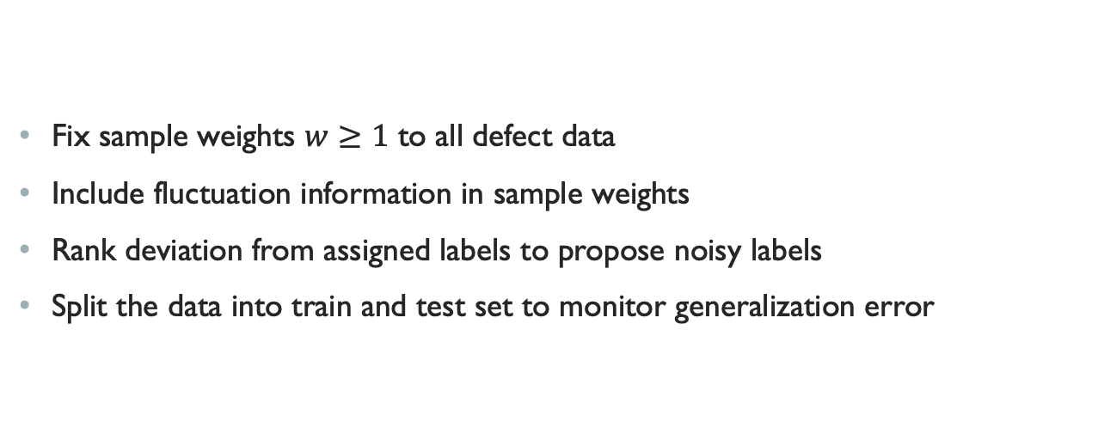
Proposed modifications
Fix sample weights $w≥1$ to all defect data
Include fluctuation information in sample weights
Rank deviation from assigned labels to propose noisy labels
Split the data into train and test set to monitor generalization error

Slide 16
Distributional shift
% (std 10-2) |  | Batch 2 |  | Batch 3
 |  | CE | SAT | CE | SAT
AUC |  | 99.83 (0.00) | 98.37 | 94.93 (0.14) | 95.79
TPR>=99.1% | FPR | 1.25 (0.08) | 28.19 | 61.22 (1.22) | 51.68
TPR>=99.3% |  | 2.21 (0.41) | 32.90 | 67.23 (0.98) | 59.24
TPR>=99.5% |  | 3.60 (0.31) | 41.59 | 75.29 (0.70) | 66.81
TPR>=99.7% |  | 4.71 (0.40) | 58.07 | 82.48 (0.65) | 71.43
TPR=1 |  | 36.80 (2.06) | 98.50 | 99.16 (0.19) | 98.74
The network is the same ResNet18 trained by Batch 2 data.
Deeper networks or FiveCrop/TenCrop tricks don’t help.
SAT somehow improves performance on Batch 3 data.

Slide 17
references
He, K., Zhang, X., Ren, S., & Sun, J. (2016). Deep residual learning for image recognition. In Proceedings of the IEEE conference on computer vision and pattern recognition (pp. 770-778).
Simonyan, K., & Zisserman, A. (2014). Very deep convolutional networks for large-scale image recognition. arXiv preprint arXiv:1409.1556.
Jaderberg, M., Simonyan, K., & Zisserman, A. (2015). Spatial transformer networks. In Advances in neural information processing systems (pp. 2017-2025).
Jetley, S., Lord, N. A., Lee, N., & Torr, P. H. (2018). Learn to pay attention. arXiv preprint arXiv:1804.02391.
Huang, L., Zhang, C., & Zhang, H. (2020). Self-Adaptive Training: beyond Empirical Risk Minimization. arXiv preprint arXiv:2002.10319.

